Slide 1
Annual General Meeting Report
Australian Institute of Interpreters and Translators
QLD Branch Committee
10 September 2022

Slide 2
Chair’s introduction
This has been a very exciting year for the QLD branch, the highlights being the organisation of the National Conference, three in-person PD events, and our work with ASLIA in improving conditions for interpreters.
As you may be aware, QLD was tasked with the job of organising this year’s National Conference, which will be held at the University of QLD in November 2022. In late January the committee met to decide on the structure of the Conference Organising Committee (OC). Every committee member raised their hand to be part of this subcommittee, and a number of AUSIT members from outside the branch committee also decided to kindly donate their time to help organise this exciting event. I would like to formally acknowledge each and every person who has contributed their time to organising this event. We have all learned a lot about conference organising and I am sure the event will be a tremendous success thanks to a lot of hard work and dedication.
.

Slide 3
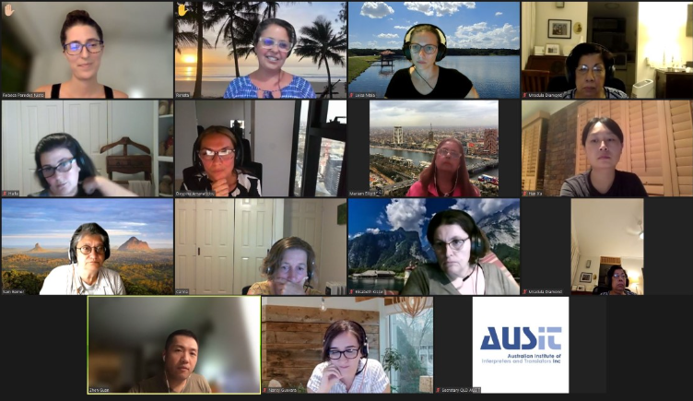
Chair’s introduction
Our PD coordinator Renata Oliveira organised two in-person professional development events and one social event to help bring practitioners back together. After having to pivot online due to the pandemic, and doing this so successfully, it was wonderful to be able to start to reconnect with colleagues in person again. We thank all of you who attended those events.
AUSIT QLD has also been working hard with ASLIA QLD to improve conditions and pay for interpreters. This started with a meeting in November with Multicultural Affairs QLD, the government department responsible for managing the contract with Language Service Providers. The latest contract, or Standing Offer Arrangement (SOA), came into effect five years ago. Ever since, interpreters in QLD have experienced a decline in their conditions and pay.
August 2021

Slide 4
Chair’s introduction
AUSIT and ASLIA were invited to provide feedback on the current SOA. We are continuing to pressure the department to take our recommendations seriously, and in order to obtain reliable data to substantiate our claims, AUSIT and ASLIA have commissioned University of Queensland to design and conduct a survey on interpreter satisfaction. The survey will soon be sent to all QLD interpreters. We do hope that as many practitioners as possible complete the survey as it will directly benefit all current and future NAATI certified interpreters.
We look forward to being able to report on improvements in the industry in next year’s AGM report.
Carina Mackenzie
+

Slide 5
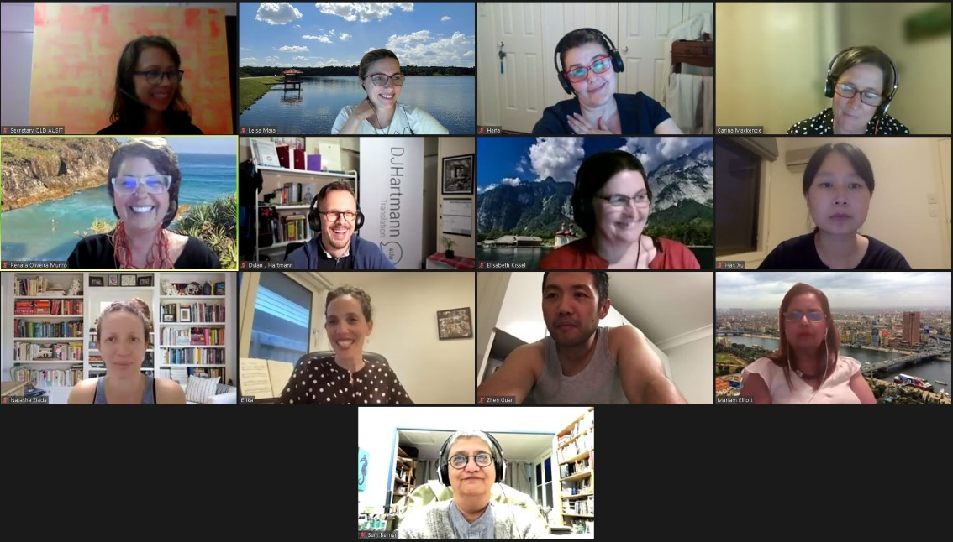
Why not be part of something great?
I would also like to take this opportunity to encourage any practitioners new and old to join the committee. A number of our long-standing members will be taking a break after volunteering considerable time to the organisation of the conference this year. We look forward to inviting newcomers to the committee.
I myself am very new to the committee and feel I have learnt a great deal about the industry over the past year. I hope that over the next year I can continue to help raise the profile of this essential service that ensures our multicultural community are linguistically present in all aspects of society.

Slide 6
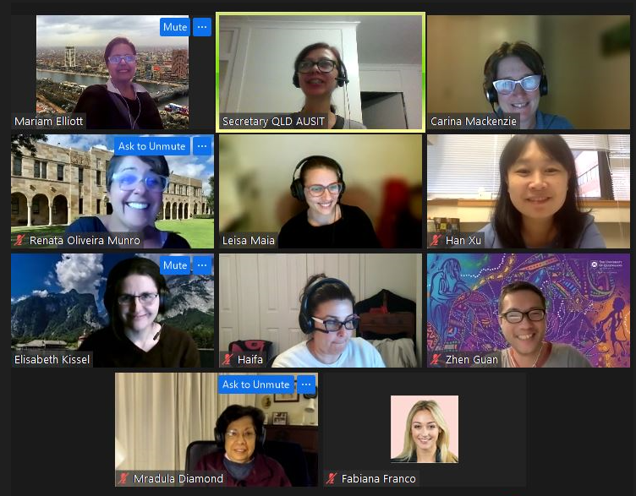
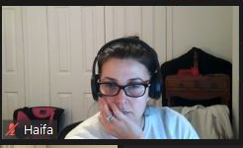
Why join the committee
Many interested members express their concern that being a member of a branch committee would mean a set of skills they do not possess. With that in mind, we decided to share with you our “set of skills”, which we are confident every committed professional thinking of joining already has:
strong commitment to the profession
a desire to share knowledge and support development
people/organisational skills
wanting to be part of bigger things and change
enjoying working with colleagues
ability to contribute ideas
a thirst for learning

Slide 7
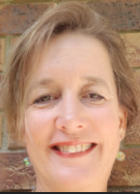
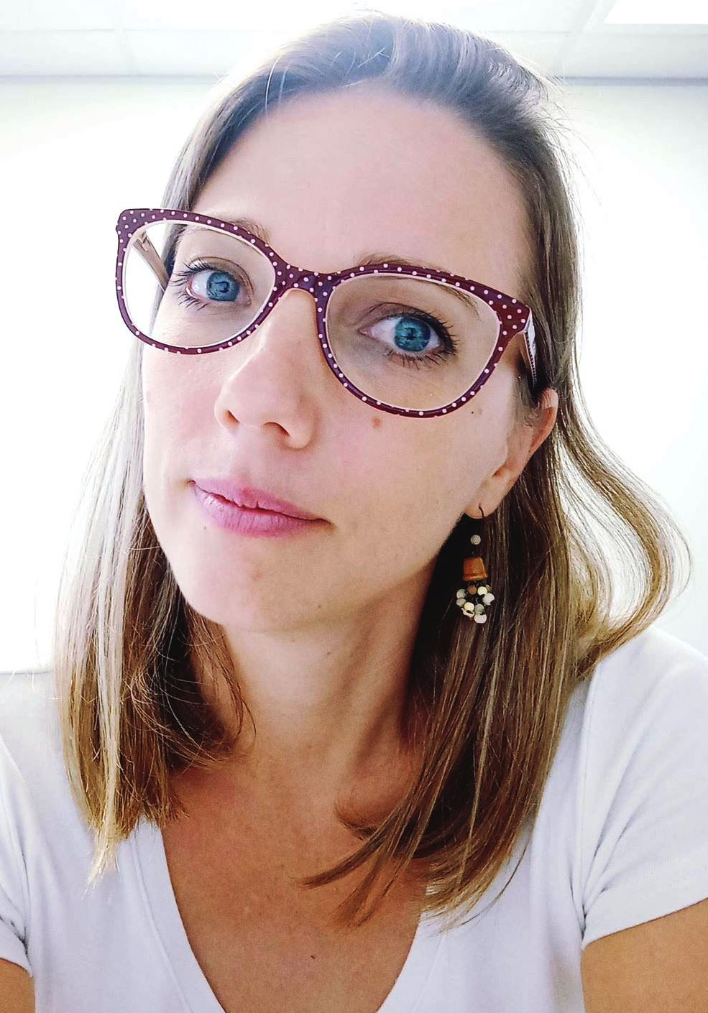
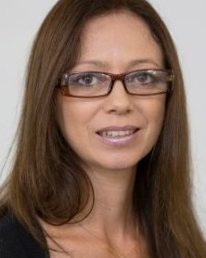
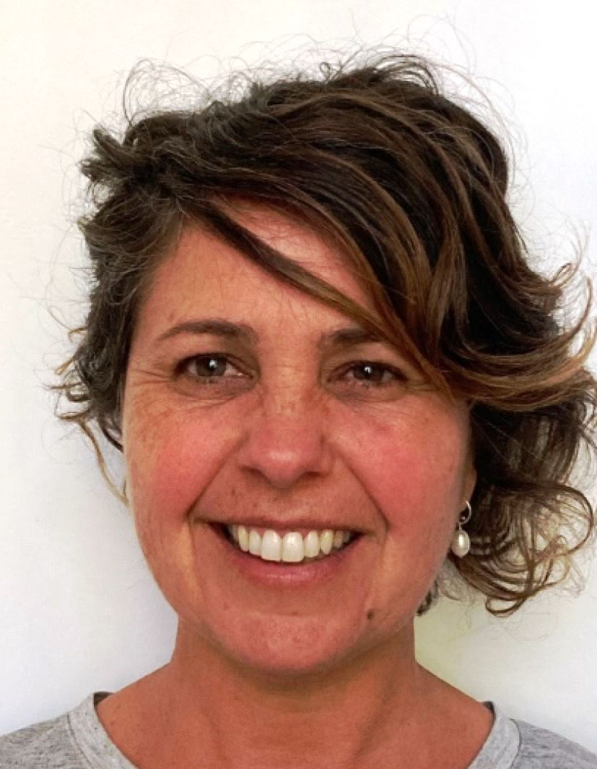
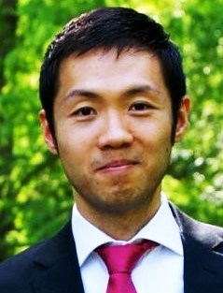
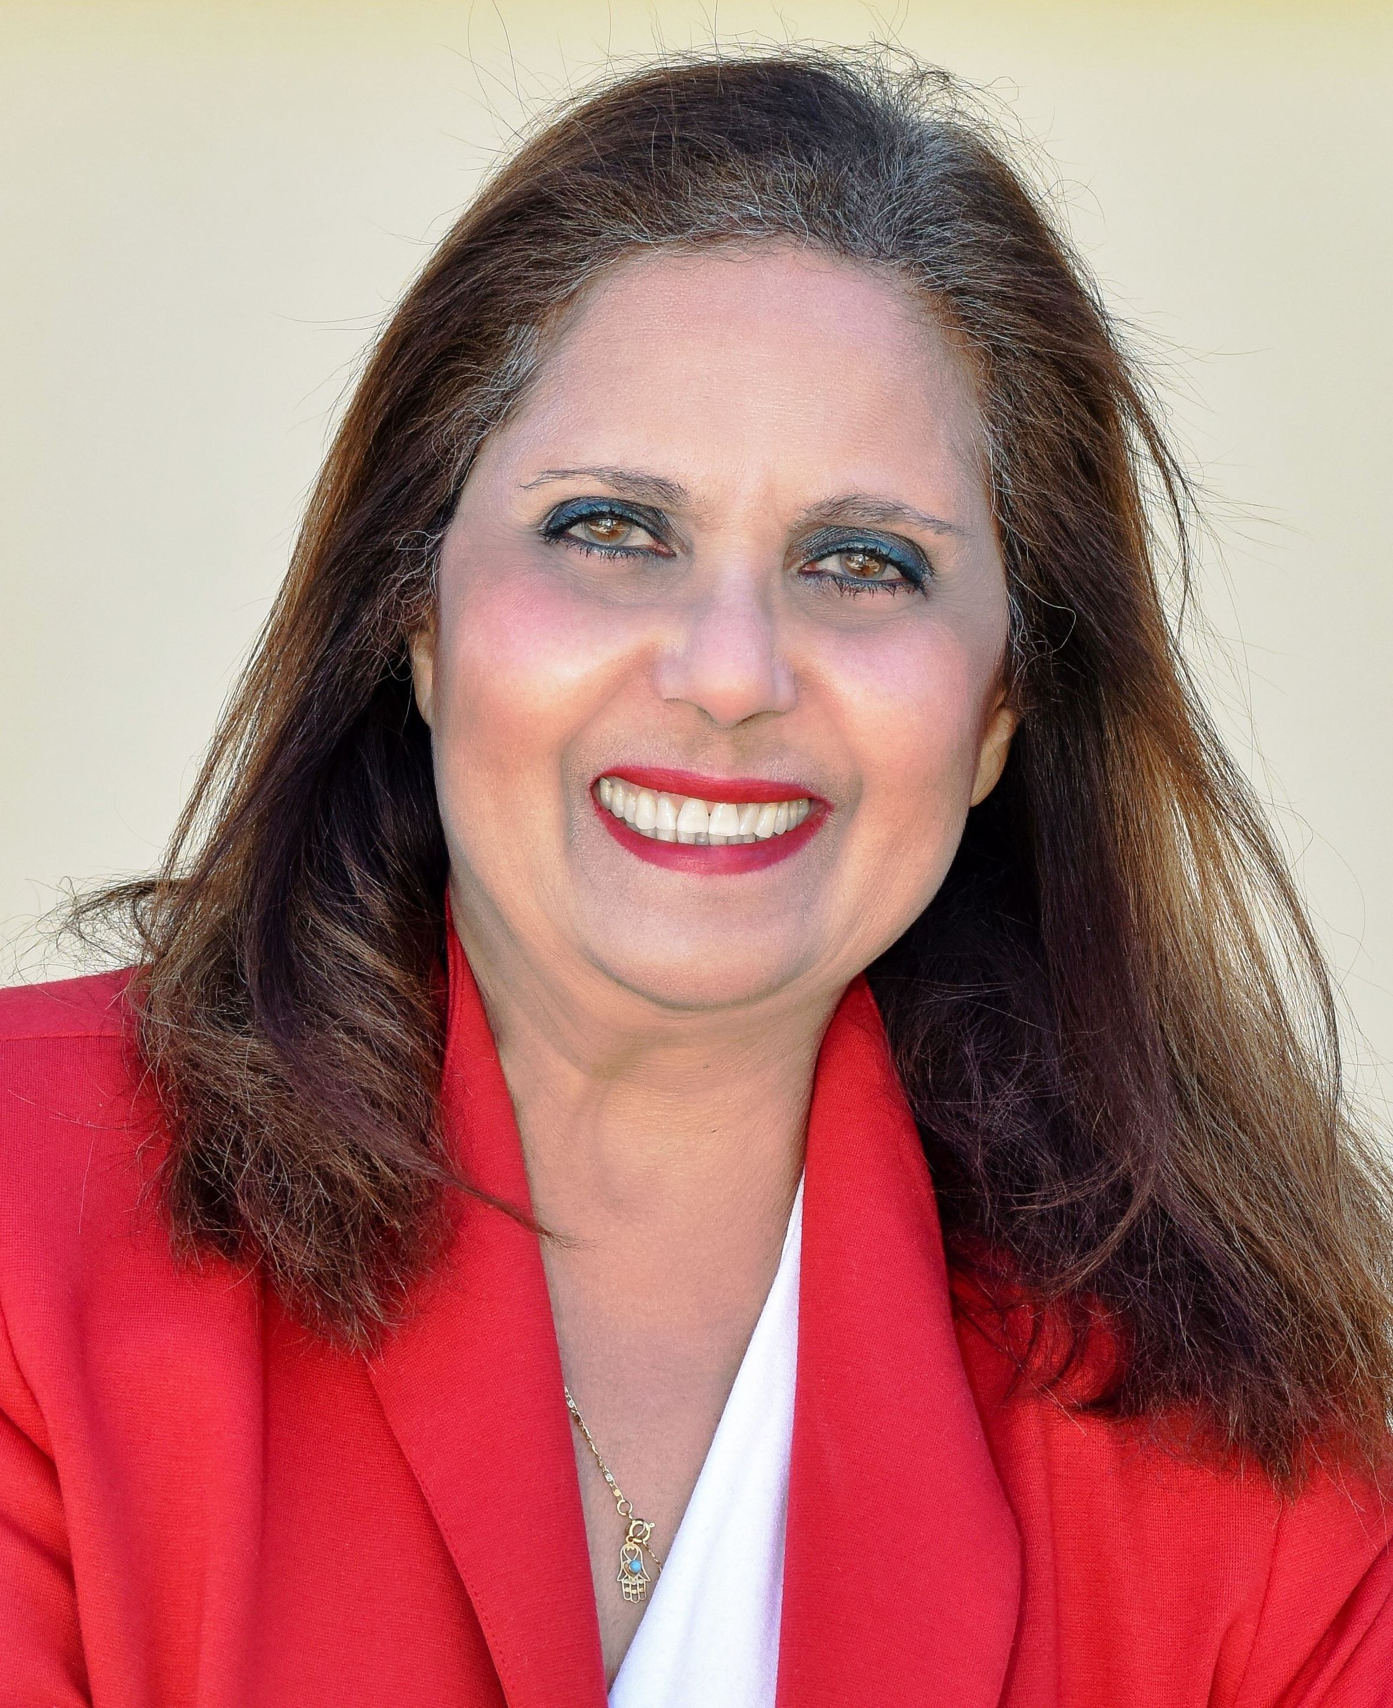
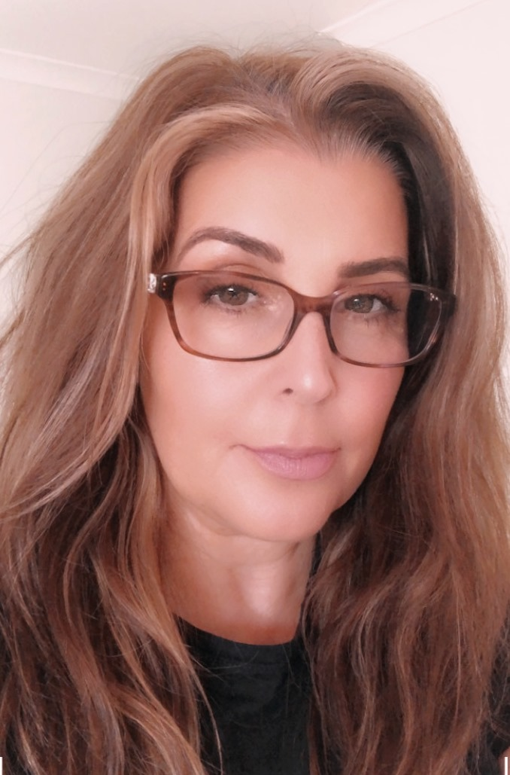
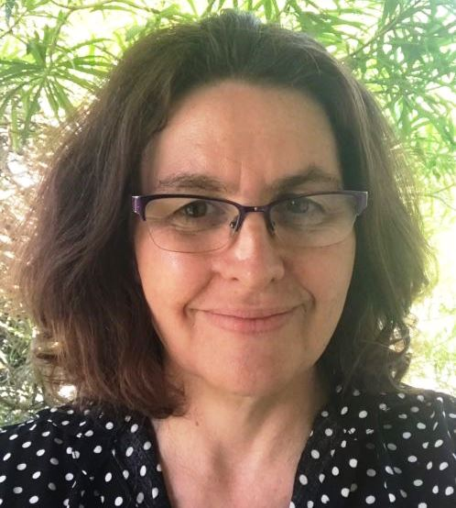
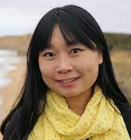
Our team
Carina Mackenzie - Chair
Leisa Maia – Vice Chair
Andrea Dallape - Secretary
Renata Oliveira –
PD Coordinator
Zhen Guan – Vice-PD Coordinator
Mariam Elliott - Member
Haifa El Kadi - Member
Elisabeth Kissel - Member
Han Xu - Member

Slide 8
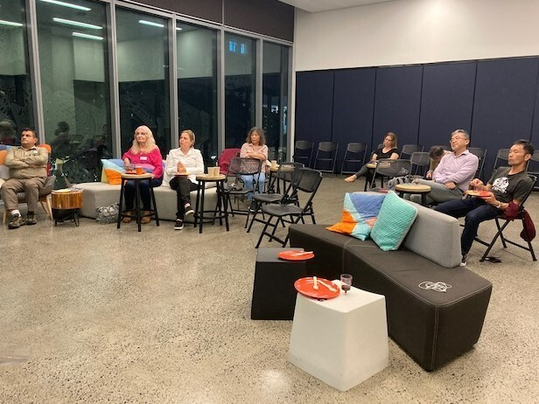
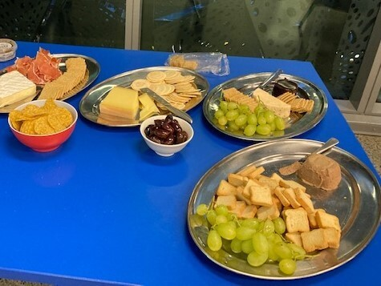
Branch activity reports

Slide 9
Professional Development: The Backbone of the Profession
With COVID-19 restrictions starting to lift, the QLD branch were thrilled to be able to get back to hosting in-person events again in 2022.
We started the year with a networking coffee event held at the Brisbane Botanical Gardens. The event was well attended by seasoned professionals and newcomers alike. It was fantastic to reconnect with colleagues and meet some new faces.
A second in-person event was held in May on Ethics for Translators. This event was held at national level and it was a blend of in-person attendance and online which allowed for fruitful discussion between participants during online breaks.
In August, the QLD branch provided a further in-person event held in the Brisbane CBD. Glenine Hamyln from the Institute of Professional Editors gave a very interesting and useful talk on the intricacies of post-editing work and the similarities and differences between translation and editing.
All efforts for the remainder of 2022 will be focused on preparations for the 2022 AUSIT National Conference, set to take place on 25-26 November at the University of Queensland.
Renata Oliveira –
PD Coordinator

Slide 10
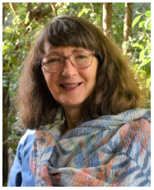
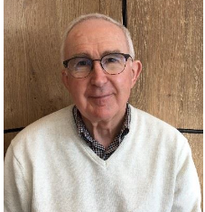
Professional Development:
Month | Event | Type | # Registrants
August 2022 | The best translator is also an editor – workshop | Face to face | 18
May 2022 | ETHICS FOR TRANSLATORS Translation of official documents: presentations and discussions on ethical issues | National Webinar | 17 face to face 235 online
February 2022 | Networking coffee at the Botanical Gardens | Face to face | 35
Presenter
Glenine Hamlyn
Presenter Dave Deck

Slide 11
Professional Development: What Our Members Say
As a student AUSIT member, this has been a really practical and helpful seminar on the business aspects of being a translator.
An interesting look at the current developments in the industry.
I have a big action list now, thanks for your help.
Very informative, especially for a beginner such as myself.
Great, well-presented & informative, thought-provoking session.
I like these online seminars. Especially if you do not live in that particular state, but can attend something that interests you
.

Slide 12
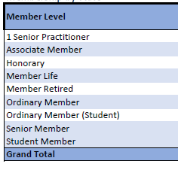
Membership Summary as at Sunday, 31 July 2022

Slide 13
Queensland Preparing Interpreters Scholarship Program
With some funds remaining from the 2020 project, AUSIT and NAATI were pleased to be able to continue to offer scholarship opportunities to speakers of languages in demand in 2022.
Three scholarship places were offered to speakers of Arabic, Persian and Italian to participate in the 10-week NAATI Preparation Course. All three recipients have successfully concluded the course and are now preparing to sit their NAATI tests. We look forward to continuing to support the students through the process of sitting their NAATI tests, and subsequent professional practice.
Of the 2020 round (a total of 7 scholarship recipients), the majority have now sat their NAATI tests. Two have successfully passed (Arabic and Thai), three are waiting to hear their results, one was unsuccessful, and the remainder is waiting for their test date to arrive.
Three of the scholarship recipients were selected to be interviewed by the association’s magazine InTouch – the interviews can be found on pages 16 and 17 of the Autumn 2022 issue. https://ausit.org/in-touch-magazine/
Leisa Maia – Vice Chair

Slide 14
Representations: Your voice to the industry
AUSIT representation at the CRH advisory group: part of a project run by True Relationships and Reproductive Health (TRUE) which aims to build the capacity of health professionals and services to improve reproductive and sexual health outcomes for people from migrant and refugee backgrounds. AUSIT participation included being involved in meetings to discuss issues pertaining to responsive reproductive health (including access to skilled interpreters and training for interpreters and translators) for CALD clients. Renata also assisted in consultations for the development of resources to be translated for women and men from CALD backgrounds (i.e. cervical screening and men’s health resources).
Renata Oliveira - Member
Collaboration between the Institute of Professional Editors and AUSIT: After two years of concentrated effort by AUSIT QLD and IPEd QLD, the IPEd CEO, Karen Lee, and branch presidents met back in February 2021 and are putting together a set of guidelines and policies regarding all of IPEd's affiliates. IPEd contacted AUSIT National Council, and a documented proposal of affiliation between the two organisations is currently on the discussion list. IPEd hosts events which would be of great benefit and interest to translators into English, and affiliation will permit members of both organisations to attend events at members’ rates. In Editors Queensland, Glenine Hamlyn, and editor and a translator, is now officially the Affiliates Liaison Officer. Glenine is also an AUSIT member.
Elisabeth Kissel - Member

Slide 15
Representations: Your voice to the industry
NAATI Regional Advisory Committee in Queensland:
Carina and Andrea have been participating in the NAATI Regional Advisory Committee meetings to discuss current issues that affect the T&I industry. This year, the main discussions were around remuneration for interpreters and the review of the Queensland government’s Standing Offer Agreement, the 5-year contract between the QLD government and the language service providers for the provision of interpreting services that expires early next year.
AUSIT has anecdotal data that suggests that the current SOA has been detrimental to our profession, causing interpreters to abandon their careers or being forced to find a second job due to low pay and working conditions. To remediate the situation, AUSIT has requested to be involved in the drafting of the next SOA.
AUSIT and other stakeholders are also working on a research project with UQ to collect empirical data on the effects of the current SOA on our industry. This research aims to find out the numbers of professional interpreters that have abandoned the profession, remuneration satisfaction, working conditions, existing complaint procedures among other issues. A survey will be ready shortly, so please make sure you take the time to complete the survey to have your say.
At the RAC meetings, we are also currently involved in negotiations with TIA, LSPs and other organizations to advocating for an industry award and Enterprise Bargaining Agreement.

