Slide 1

Annual General Meeting Report
Australian Institute of Interpreters and Translators
QLD Branch Committee
16 August 2023

Slide 2
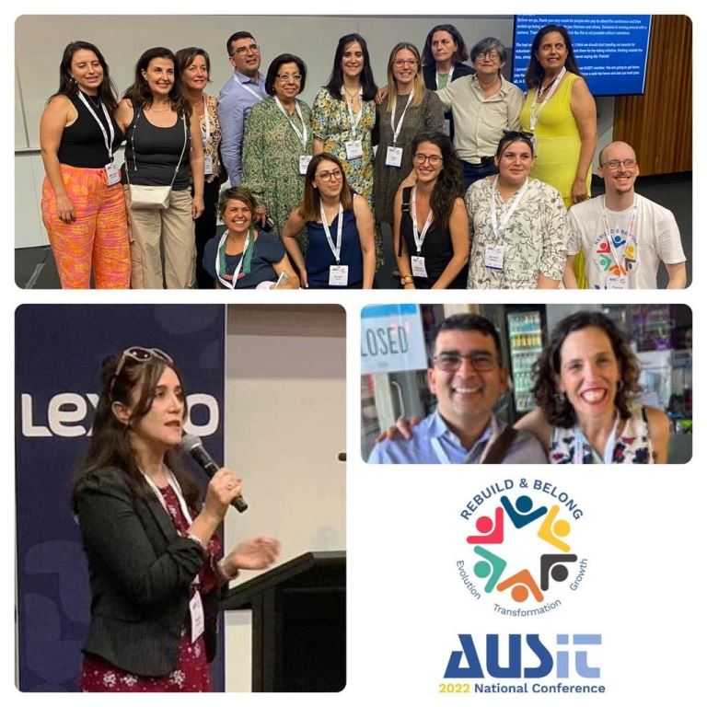
Chair’s introduction
It has been an exciting year for the Queensland branch. The committee year started with final preparations for the Brisbane National Conference held at the University of Queensland in November 2022. The event was a resounding success thanks to the hard work and dedication of our branch committee and the additional volunteers who put their hands up to organise the event.
For all involved, it was a multifaceted learning experience that extended far beyond the event itself. The skills, knowledge, and connections we all gained will have a lasting and positive impact on our personal and professional journey.
In addition to the conference, the Queensland branch organised three social events, two in Brisbane, one the Sunshine Coast, and one in Cairns, as well as two PD sessions, one online and one in person. We look forward to offering more engaging social events over the course of 2024.

Slide 3
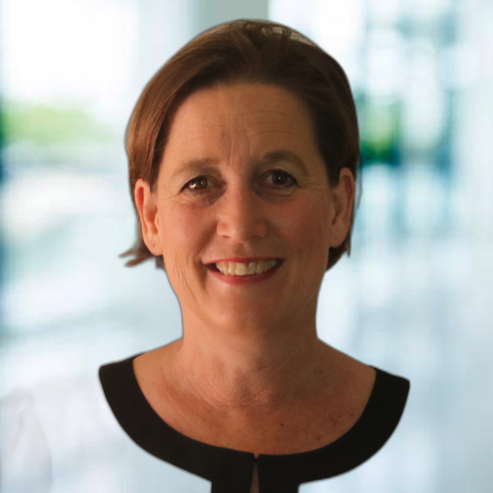
Chair’s introduction
The Queensland branch has also been actively advocating for practitioners. As it is interpreters who are most affected by government language service contracts, this is where our efforts have been focused.
In December, AUSIT Queensland and ASLIAQ (Australian Sign Language Interpreters Association Queensland) formally presented the results of the University of Queensland’s Interpreter Satisfaction survey to the NAATI Regional Advisory Council and then later to the Refugee Health Interpreter Working Group and the Culturally Responsive Health Advisory Group. It is important that all stakeholders understand that the sustainability of the profession is at risk; and this is why we are presenting the report at every opportunity.
AUSIT and ASLIAQ presented the report to QLD Health, Multicultural Affairs and then nationally. This was followed by a workshop with Multicultural Affairs, QLD Health and the Department of Home Affairs to discuss the findings and provide suggestions for improving working conditions and remuneration for interpreters. The Department of Home Affairs then established a committee to review language services nationally and we look forward to seeing the outcomes of these meetings and their findings over the next year. AUSIT Queensland, ASLIAQ and Rob Aurbach also presented the eye-opening findings of the report to a room full of health professionals who engage interpreters on a daily basis at the Multicultural Health Symposium in Brisbane in May.

Slide 4
Chair’s introduction
AUSIT also attended a Fair Work Hearing on the award that is being proposed for translators and interpreters. AUSIT looks forward to engaging with all parties to reach an agreement on acceptable rates and conditions for practitioners.
We look forward to continuing to work in this space over the coming year and hope to see some improvements. All preparation and attendance at meetings were carried out free of charge, although member funds were used to cover one registration fee and 500 leaflets for the Multicultural Health Symposium. This is just one example of how your continued membership of AUSIT will assist in these efforts. In addition to being a member, there are many other ways you can contribute to the organisation.
Please contact qld@ausit.org if you are interested
in finding out more.

Slide 5
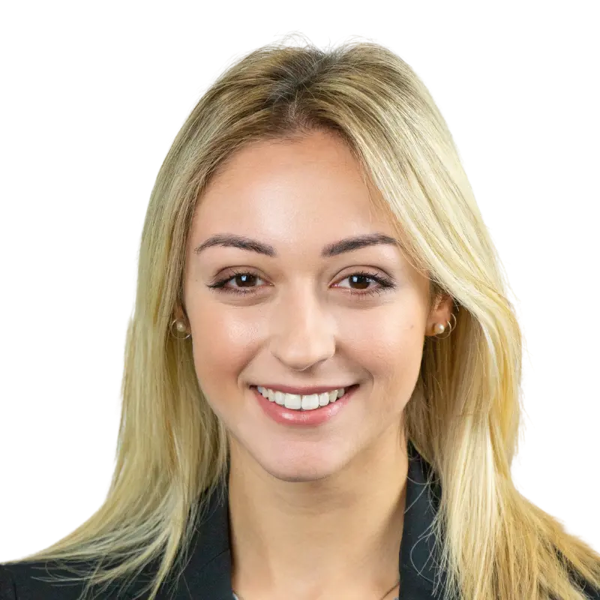
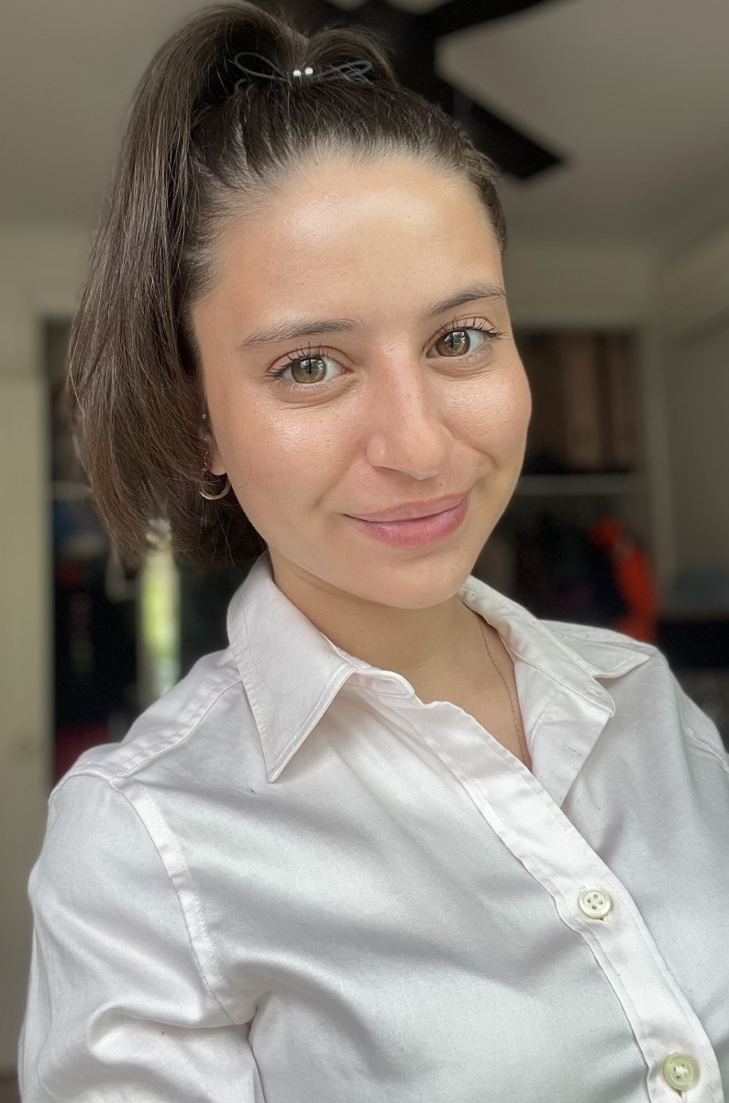
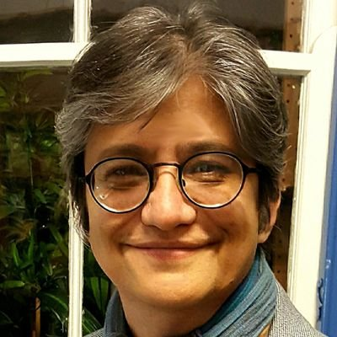
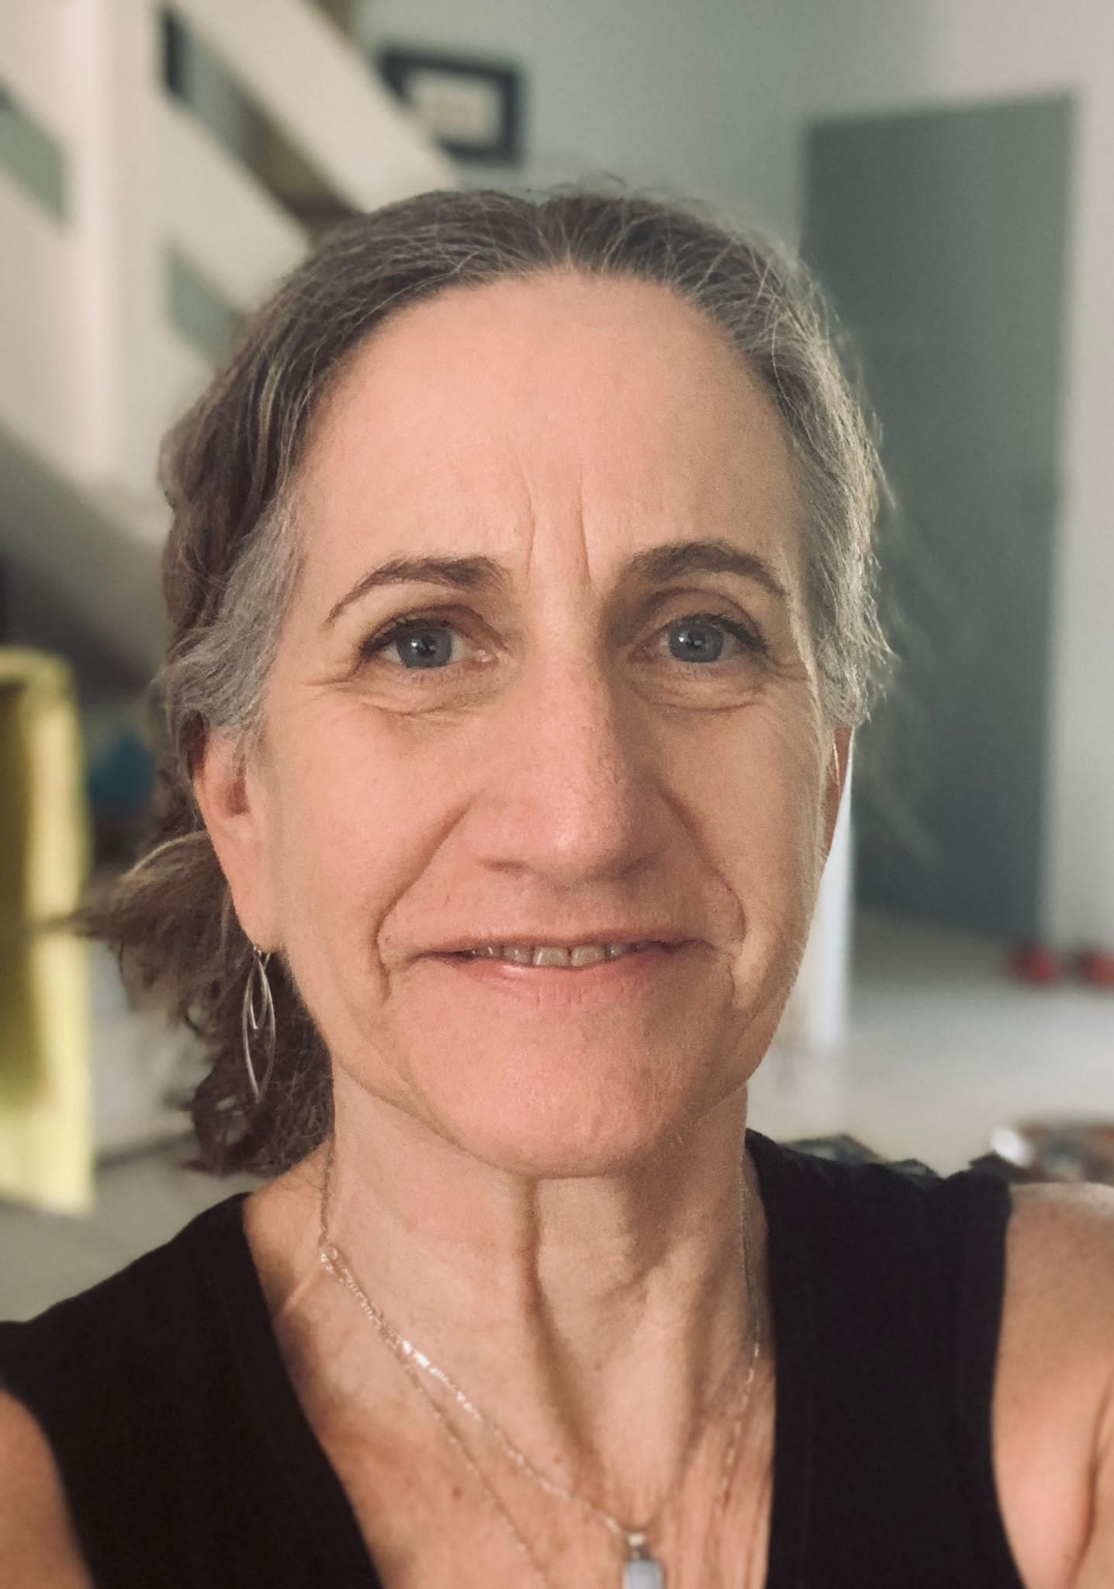
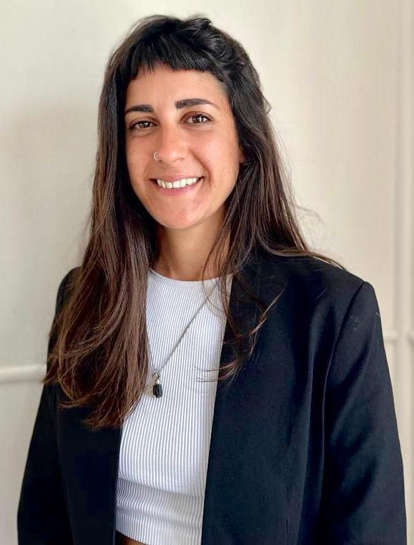
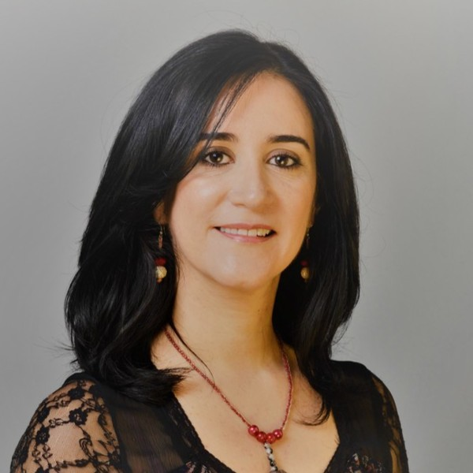
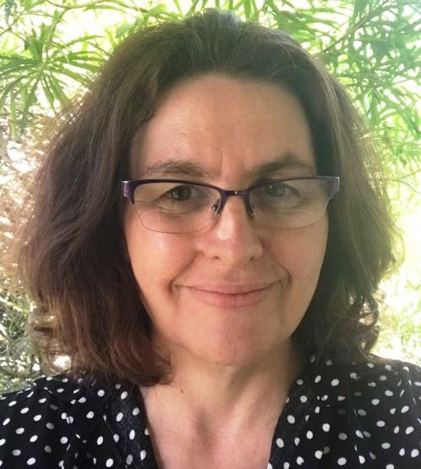
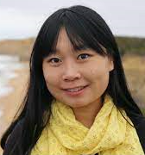
Our team
Carina Mackenzie – Chair
Fabiana Franco – Membership
Macarena Paz Kotek – Secretary
Sam Berner – PD Coordinator
Jo Ellis – Member
Candela Malizia – Member
Nancy Guevara – Member
Elisabeth Kissel – Member
Han Xu – Member

Slide 6
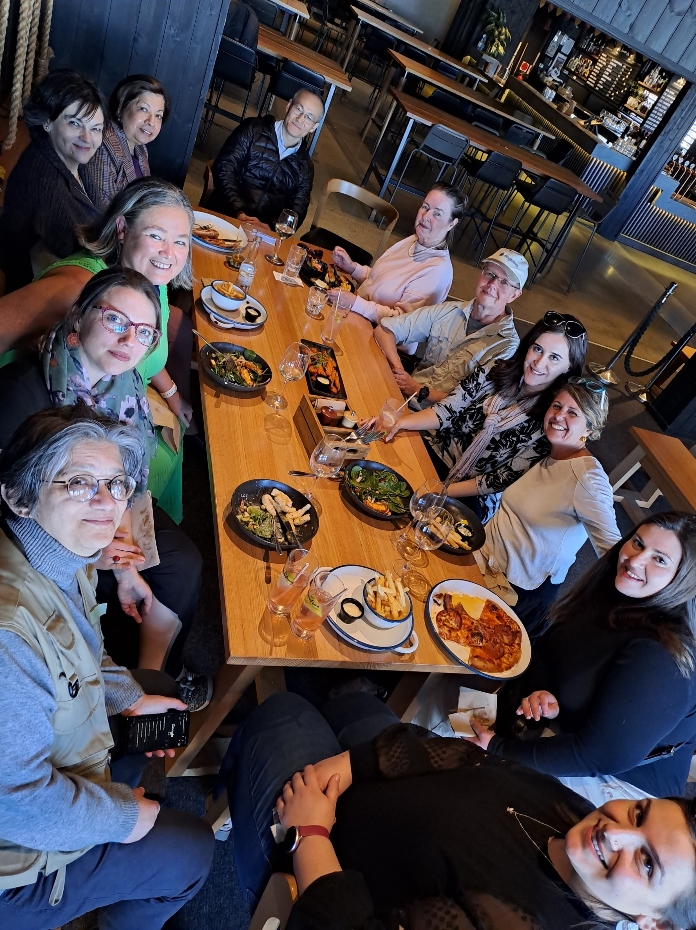
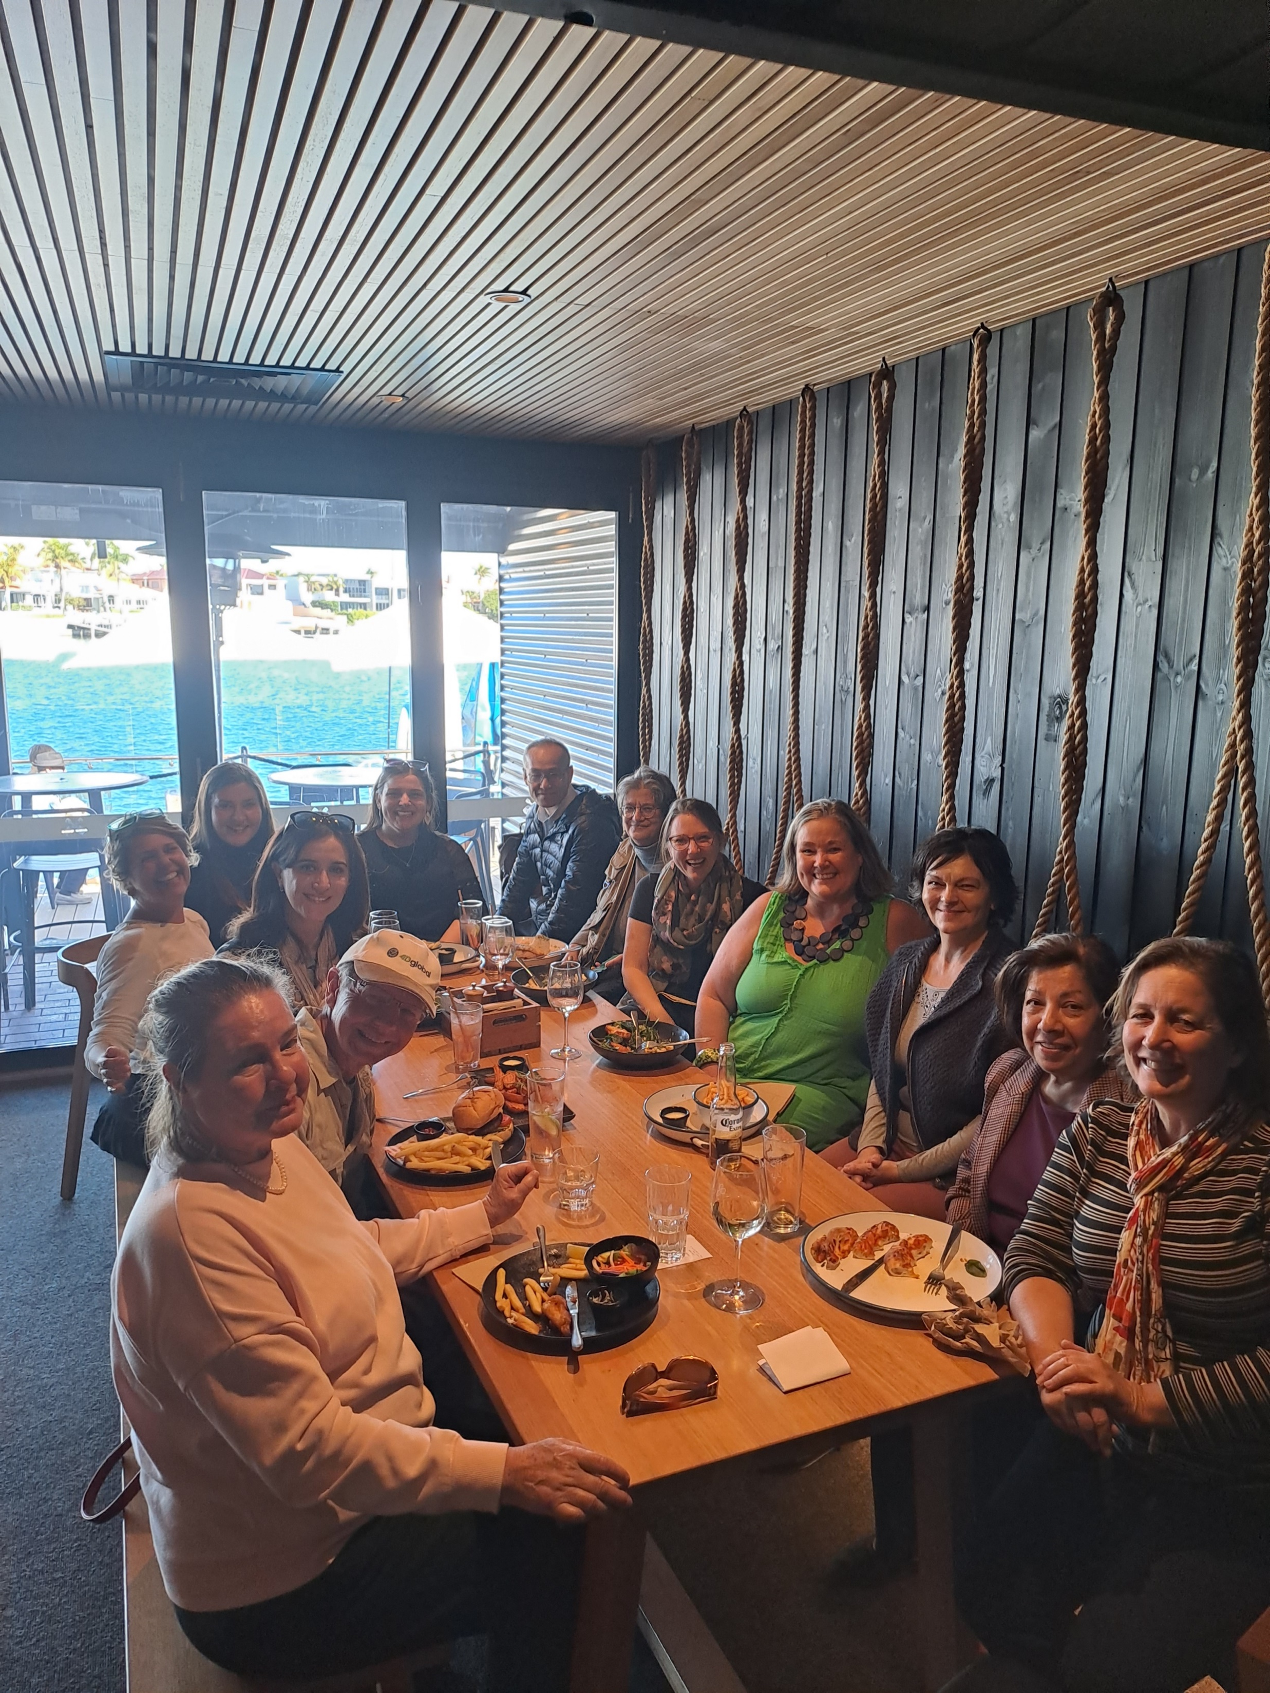
Branch activity reports

Slide 7
Professional Development:
The Backbone of the Profession
It is with immense pride and satisfaction that the AUSIT QLD Branch reflects on the resounding success of our Annual National Conference held in Brisbane last year. This event, a testament to the dedication and hard work of our branch committee, was a landmark occasion that will be remembered for years to come.
A conference, however, is not just about learning. The social events we organized were the cherries on top. The cocktail evening on the eve of the conference set the tone, allowing attendees and sponsors to mingle and network in a relaxed atmosphere. The gala dinner, held at a 5-star hotel in the heart of Brisbane City, was an evening of celebration and camaraderie. The awards ceremony recognized the outstanding contributions of our outgoing president, while the entertainment had everyone on their feet, dancing the night away.
The Brisbane 2022 conference was not just an event; it was a statement. A statement of our commitment to excellence, our dedication to our members, and our vision for the future. As we look back, we do so with a sense of accomplishment and a touch of pride.
To all who attended, sponsored, presented, and contributed in countless ways, we extend our heartfelt gratitude. We look forward to meeting you again in Sydney this November!
Sam Berner –
PD Coordinator

Slide 8

National Conference 2022
With over 250 attendees from diverse backgrounds and specializations, the conference was a melting pot of ideas, innovations, and inspirations. The sheer number of participants not only showcased the growing interest in our field but also the trust and respect AUSIT has garnered over the years.
Each session was a testament to the expertise and passion of the members of our profession, and with 80 presentations spanning a wide range of topics, discussion panels that provoked thought and debate, workshops that fostered skill development, and plenary lectures that provided insights into the past and future of our profession, we can confidently say that our conference was a great success.
Our wonderful sponsors ensured that the event was not only intellectually enriching but also grand in scale and execution. Their contributions, combined with the vibrant trade exhibition, added depth and dimension to the conference, making it a holistic experience for all attendees.

Slide 9
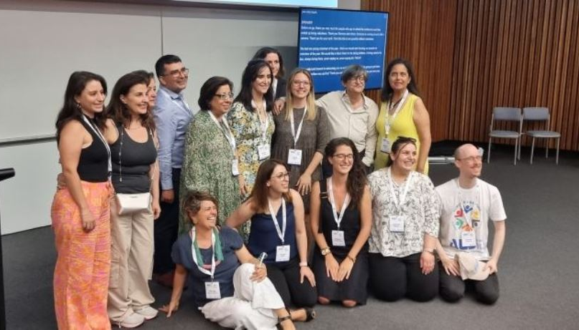
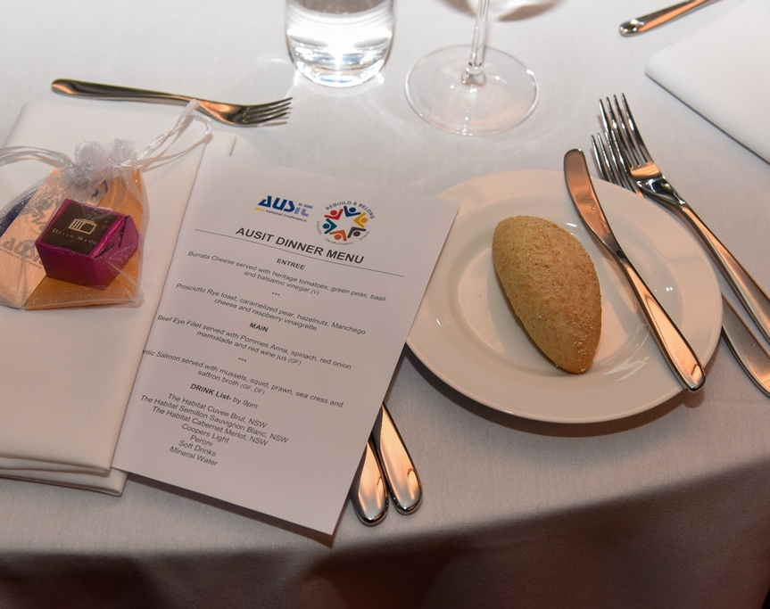
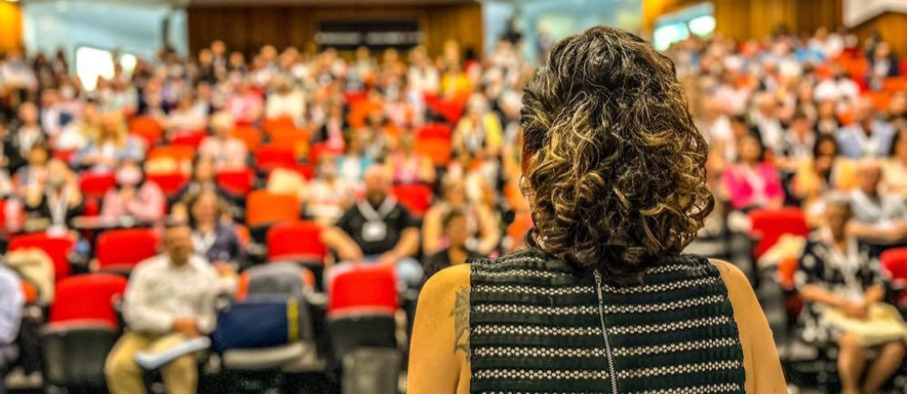
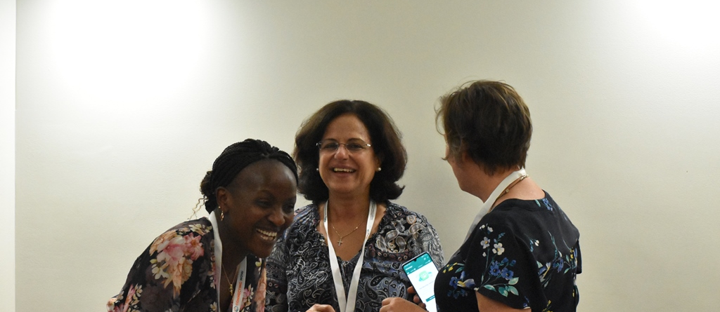
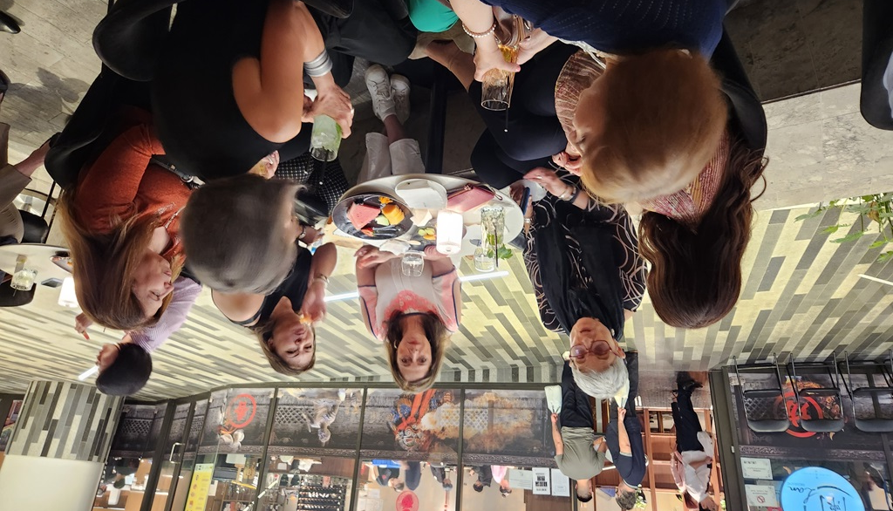

Slide 10
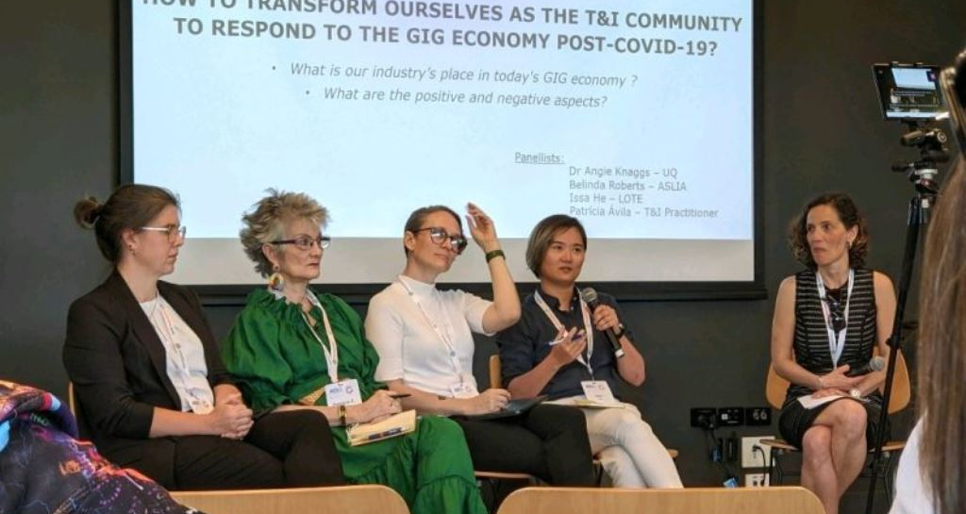
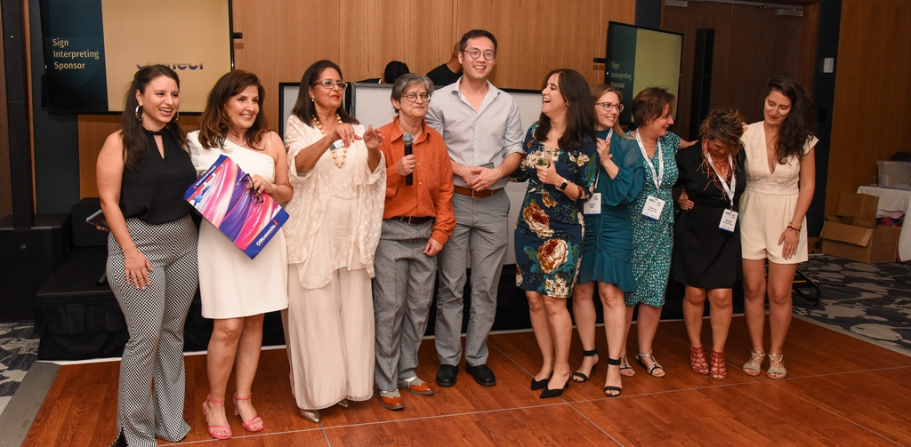

Slide 11

320 face-to-face attendees
Over 55 presentations
More than 80 presenters
and panelists
130 online participants
6 posters
4 panel discussions
2 plenaries
1 keynote
1 workshop
and the Jill Blewett Lecture
20 sponsors and 10 sponsor’s booths

Slide 12

Professional Development Events
Month | Event | Type
November 2022 | AUSIT National Conference in Brisbane | Hybrid: Face to face and Remote
February 2023 | Chat Breakfast: Let's Talk about Adding Value in Brisbane | Face to face
July 2023 | Sunshine Coast Informal Lunch | Face to face
August 2023 | Linguists and the Law: A practical seminar for QLD T/I practitioners in Brisbane | Face to face
September 2023 | Translator’s Day event in Brisbane | Face to face
September 2023 | Translator’s Day event in Cairns | Face to face

Slide 13
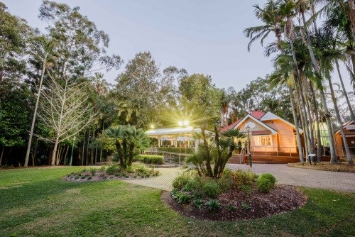
Brisbane Social Breakfast
In February, the QLD Branch celebrated its inaugural 2023 social gathering at the picturesque Brisbane Botanic Gardens Cafe. With a good turnout, attendees enthusiastically participated in a forward-thinking game, envisioning the future for translators and interpreters post-Covid. Conversations buzzed around strategies to align fees with Australia's stagnating economy. The atmosphere was charged with positivity, reflecting on the successful 2022 National Conference. Our Branch Chair shared updates on AUSIT's consultations with the QLD Government, highlighting the survey about professional satisfaction for public service interpreters. The day was graced with splendid weather and top-notch coffee. We had so much fun we forgot to take a photo!

Slide 14
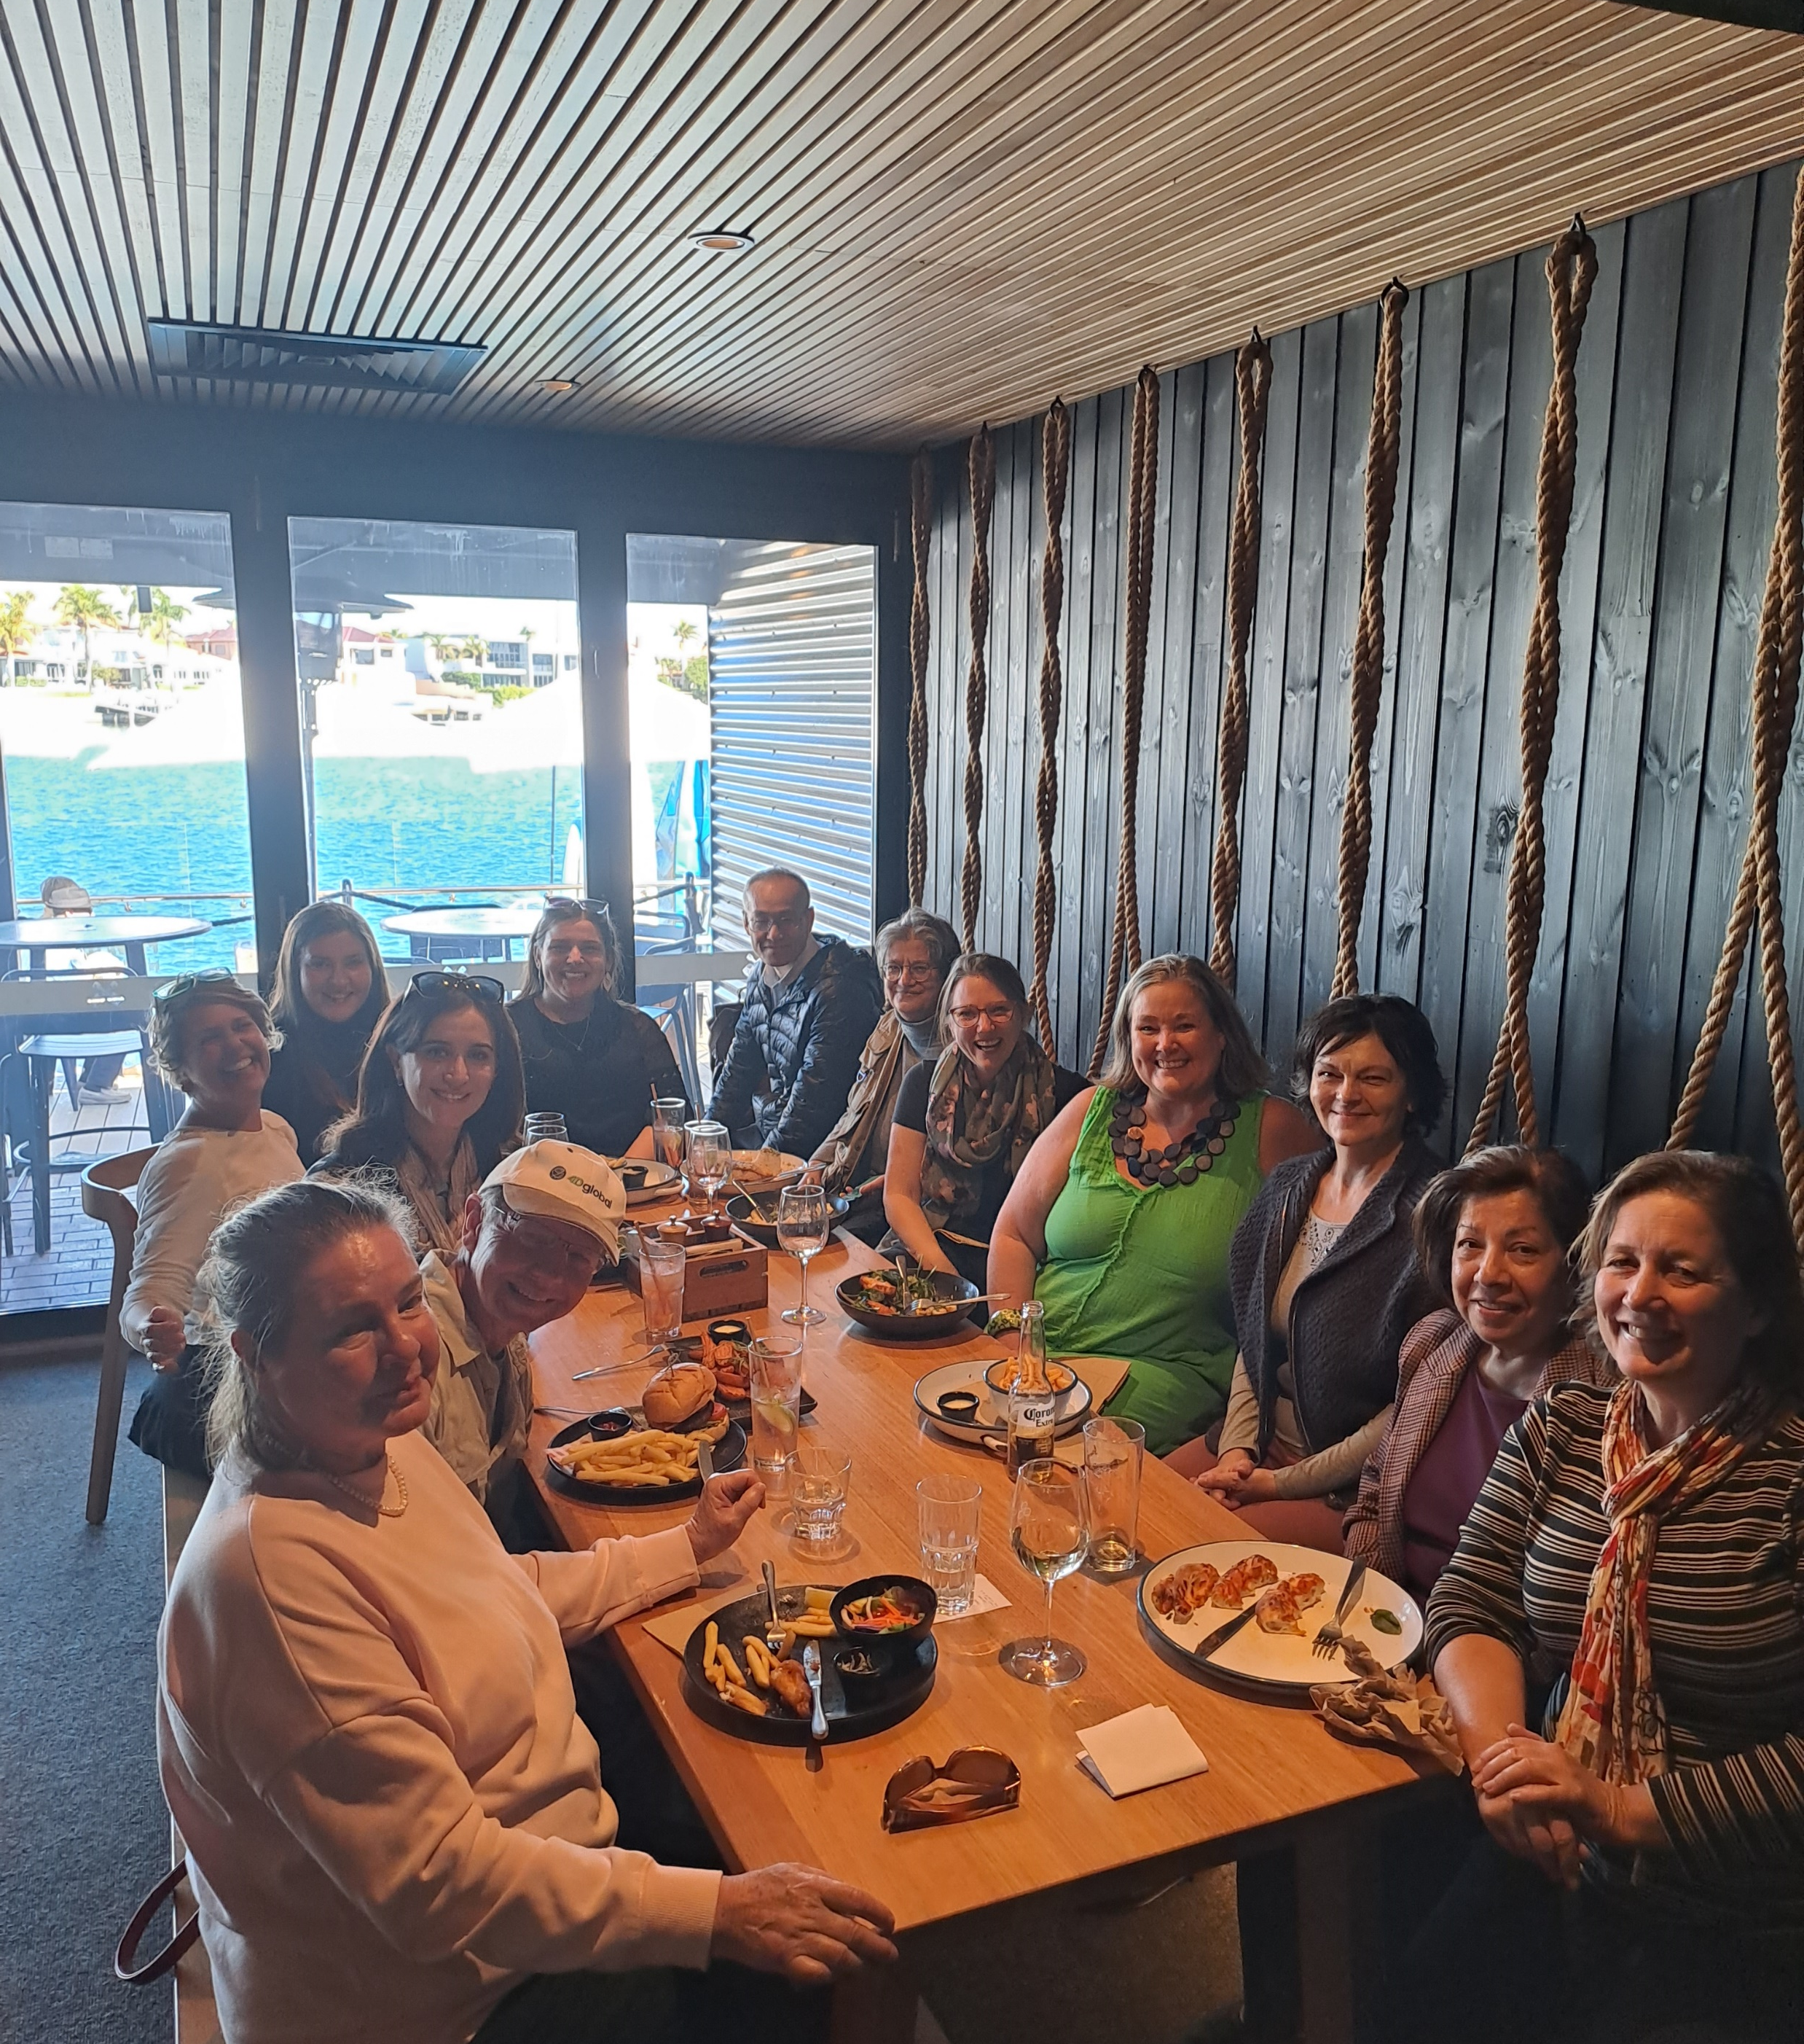
Sunshine Coast Social Lunch
QLD Branch held a delightful social lunch on a sunny winter’s day on the Sunshine Coast in July.
The stunning location provided the perfect opportunity to catch up with colleagues and discuss all topics T&I related in a relaxed atmosphere.
We had members not only from the Sunshine Coast attend the event, but also from Brisbane and Toowoomba. Thank you for trekking all way to us!
We look forward to organising more events such as these in the near future as we know some people missed out.
If you enjoy attending and organising events, please get in touch with us. The PD coordinator position is open!

Slide 15
Membership Package
In the preceding financial year, the QLD committee proactively developed a welcome pack aimed at enhancing the onboarding experience for incoming members. This innovative approach encompasses a three-week welcome series delivered through a sequence of well-timed emails, curated to seamlessly integrate new members into the association and ensure they derive maximum value from their membership.
The welcome series comprises an introductory email that extends a warm reception to new members while acquainting them with the association's mission and the privileges of membership. This is followed by an email outlining the breadth of services and programs on offer, elucidating the channels through which members can access them, and encouraging participation in upcoming events. The series culminates with a personalized message expressing gratitude for their decision to join and offering assistance with any queries they may have, while also introducing the new mentoring program and inviting them to participate.
This initiative underscores the QLD committee's dedication to fostering an inclusive community and ensuring new members embark on a fruitful journey within the association.
Fabiana Franco – Membership Officer

Slide 16
Membership Summary 2023
New Members 2023 | 53
Level | Total
Ordinary Members | 290
Student Members | 17
Associate Members | 7
Senior Member | 1
Senior Practitioner | 7
Total | 325

Slide 17
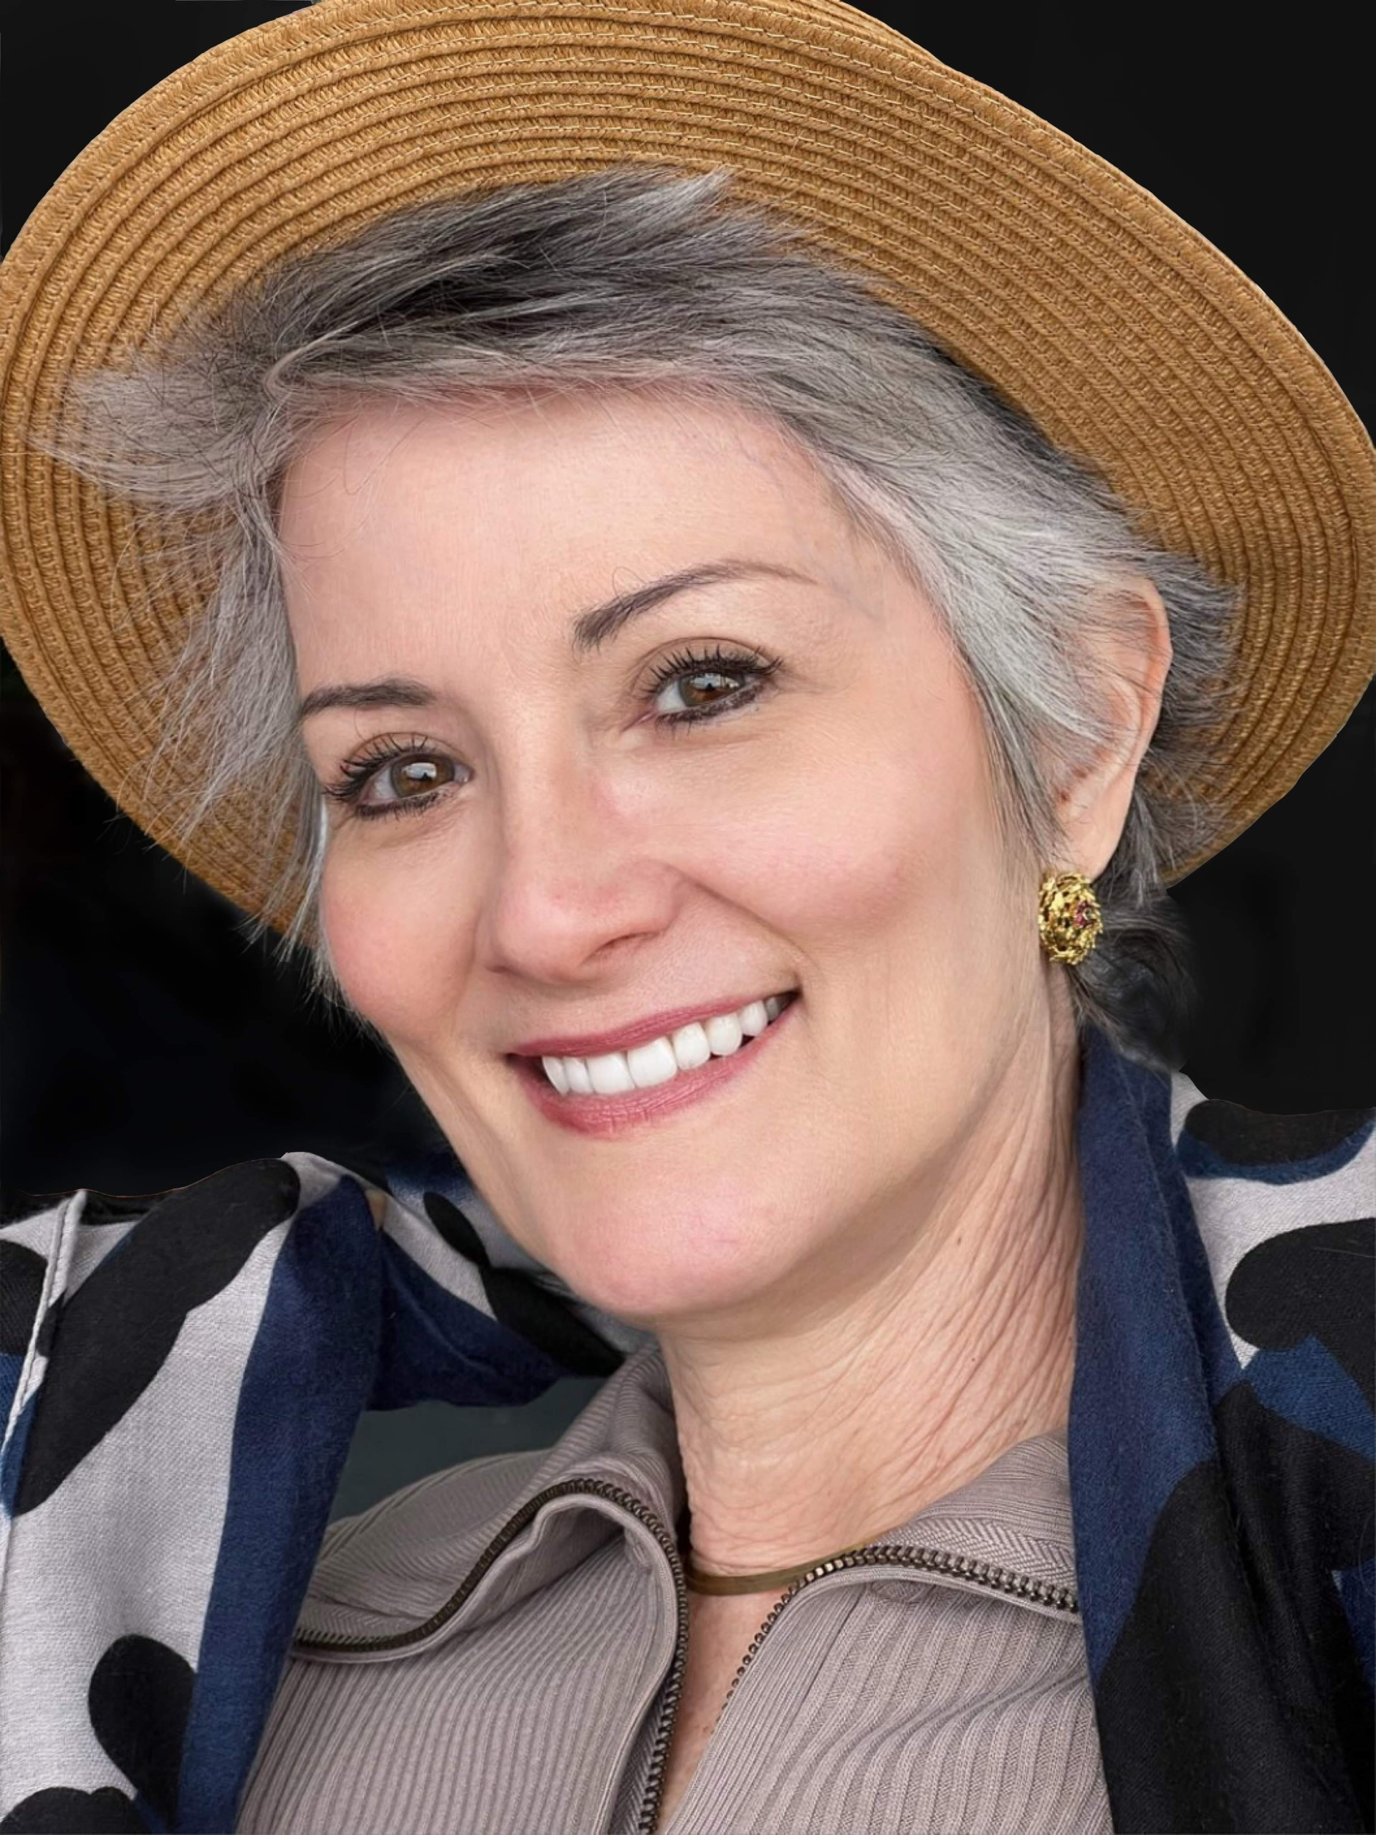
Representations: Your voice to the industry
NAATI Regional Advisory Committee (NAATI RAC)
This committee comprising NAATI QLD, AUSIT QLD, ASLIAQ, Multicultural QLD, QLD Health, QLD Courts, TAFE QLD, University of Queensland, Multicultural Australia, Australasian Association of Language Companies, meets four times a year in a hybrid format to discuss issues related to translation and interpreting. The meetings provide all stakeholders a chance to meet, share challenges and discuss ways to improve language services for our CALD communities.
Interpreter sustainability was an issue that was frequently raised at these meetings and although previous attempts had been made to conduct a survey of language service practitioners, they had not been successful. This year, thanks to efforts by NAATI RAC members, the University of Queensland conducted a rigorous survey providing the empirical data necessary for a report on interpreter satisfaction and sustainability of the industry. The report published in December last year clearly shows the sustainability of the profession is at risk and highlights the importance of engaging with all stakeholders, including AUSIT, when designing systems for the procurement of language services (SOA) by government.
Carina Mackenzie –
Chair
Patricia Argüello –
AUSIT representative

Slide 18
Representations: Your voice to the industry
Refugee Health Network Interpreter Working Group
The Refugee Health Network Interpreter Working Group was reconvened late 2022 as a space for health services and representatives of CALD communities to discuss and find ways to resolve issues relating to interpreting services. AUSIT presented the Queensland Interpreter Satisfaction Report to the group to ensure that all stakeholders understood that the sustainability of the profession is at risk. AUSIT remains committed to participating in this group to help understand the needs of other stakeholders and share with them the pressures our practitioners face.
Carina Mackenzie –
Chair
Patricia Argüello –
AUSIT representative

Slide 19
Representations: Your voice to the industry
Multicultural Health Symposium
AUSIT, ASLIAQ and Rob Aurbach from Uncommon Approach delivered a presentation at the Multicultural Health Symposium in May this year.
Findings from the Interpreter Satisfaction Survey were presented to a room full of attendees who share the goal of improving the health outcomes of our multicultural communities. Nearly every session mentioned the important role T&I plays in each of the different areas of multicultural health. Naturally, it came as a surprise to many of the attendees to hear how many interpreters are intending to leave the profession due to rates of pay and working conditions that are not commensurate with our role and responsibilities. ‘This was the most refreshing session of the day’, ‘I had no idea’, ‘This needs to change. What can we do?’ ‘Why is there such a pay gap between spoken and sign language interpreters?’ was just some of the feedback we received.
We would like to thank Angel Bogicevic from Queensland Health and Jim Duncan from NAATI for their unwavering support, as well as all Queensland interpreters who completed this survey to make this all possible.
Carina Mackenzie –
Chair
Patricia Argüello –
AUSIT representative

Slide 20
What is True?
Representations: Your voice to the industry
True Relationships & Reproductive Health (TRUE) is a profit-for-purpose organisation, established in 1972. Their goal is to achieve substantial, positive social impact by improving reproductive and sexual health and promoting safe and respectful relationships. TRUE delivers expert clinical services, education and counselling. Patricia Argüello de Avila is AUSIT's representative with this group.
Some of TRUE's activities in the last 6 months:
956 health professionals, interpreters and translators, community workers, and community members trained and supported,
Health in My Language (HIML) engaged with 610 people in the community, offering valuable support and improved access to information and services,
Culturally Responsive Female Genital Mutilation / Cutting Awareness Care training, carried out in partnership with NETFA , QPASTT, and community health leaders,
Facilitated the integration of cultural responsiveness in training and content,
Presentation at A Culture of Care: Multicultural health symposium (Queensland Health) on sexual and reproductive health education for migrant and refugee communities."
Patricia Argüello –
AUSIT representative

Slide 21
Student
Excellence
Awards
Rachel Yuanqiu Zhang, University of Queensland
Xiaoyun Xiaoyun Zhu, University of Queensland
Suky Sham Pui Ling, University of Queensland
Annual General Meeting Report
21

Slide 22
Nominations
Chair
Secretary
Treasurer
Branch Delegate to National Council
Deputy Branch Delegate
PD Coordinator
Membership Liaison Officer
Committee members

Slide 23
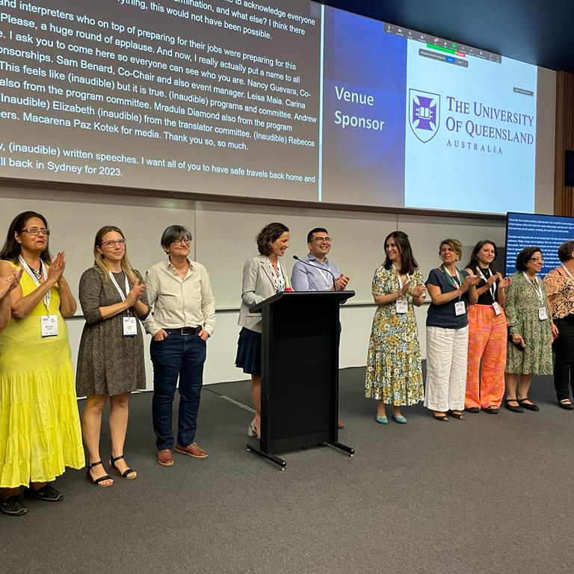
Why not be part of something great?
Being a member of AUSIT offers many benefits, including access to professional development opportunities, networking with other industry professionals, and representation at a national level.
AUSIT is dedicated to promoting and supporting the interpreting and translating industry in Australia, ensuring our multicultural communities are linguistically present in all aspects of society.
Whether it's attending our events, participating in professional development opportunities, or connecting with other members, there are many ways to engage with the association's community.

Slide 24
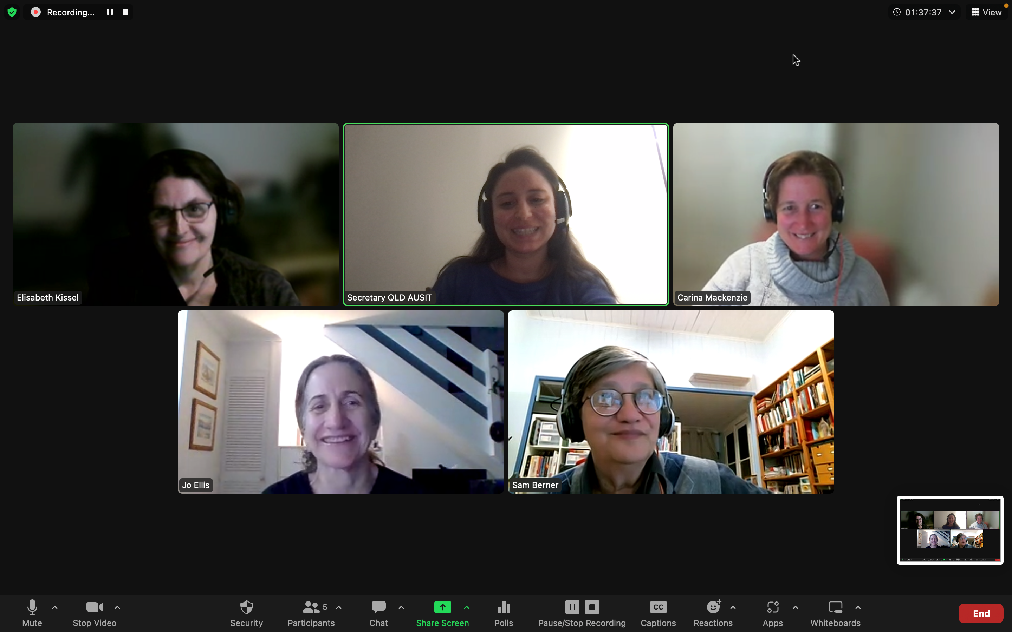
Why join the committee
Help raise the profile of the industry by participating and sharing valuable insight with others
Raise the profile of the industry by strength in numbers and showing a strong commitment to the profession
Learn more about the industry
Keep up to date with the profession
Get benefits for being an AUSIT member, such as PD development opportunities

Slide 25


